Slide 1
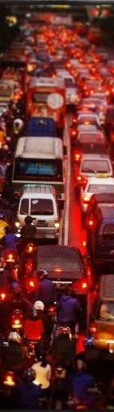

Co-benefit
Advance Auto-Technology:
Daya Saing Industri dan Penurunan Emisi
Public Discussion “Tantangan Menuju Standard Euro 6 - FORWOT
Jakarta, 27 Juli 2016
Ahmad Safrudin
KPBB, 12th Floor Sarinah Building, Jalan MH Thamrin #11 Jakarta 10350 INDONESIA
ph +6221 31906807 f +6221 3153401 mobile +62816897959
Skype a_safrudin; email: puput@kpbb.org; ahmadsafrudin.blogspot.com; www.kpbb.org

Slide 2
Outline
Latar belakang:
  Pencemaran udara
  Adopsi Low Emission Vehicle:
    Pengendalian Pencemaran Udara
    Daya Saing (competitive advantage) Auto Industry dan Oil Industri nasional
    CBA and CEA Low Emission Vehicle Standard (Euro 4)
Kualitas BBM, Prasyarat Adopsi Low Emission Vehicle Standard
Benchmark existing and roadmap fuel quality/pricing di negara2 tetangga:
  Malaysia
  Australia
Ringkasan

Slide 3
Pencemaran Udara
Pencemaran udara telah menjadi ancaman serius bagi masyarakat terutama mereka yang tinggal di kawasan perkotaan dengan kepadatan kendaraan bermotor yang tinggi.
  WHO merelease laporan terbaru bahwa pada 2012 (Ref: News release WHO/06, 25 March 2014):
  Seperdelapan kematian umat manusia di seluruh dunia (atau sekitar 7 juta jiwa per tahun) akibat terpapar pencemaran udara.
  Dari jumlah itu, 60.000 jiwa terjadi (meninggal) di Indonesia.
Di Jakarta sendiri 57,8% warganya menderita sakit/penyakit akibat terpapar pencemaran udara (slide 9), sehingga harus membayar biaya berobat mencapai Rp 38,5 Triliun.
Selain menyebabkan pencemaran udara, tingginya emisi dari berbagai aktivitas manusia juga menyebabkan peningkatan Gas Rumah Kaca terutama CO2, CH4, N2O, O3 yang berdampak pada perubahan temperature global dan mendorong terjadinya pemanasan global (global warming).
  Hal ini memicu peningkatan intensitas bencana baik bencana alam (banjir, badai, tanah longsor, peningkatan permukaan air laut dll) maupun penyakit seperti meluasnya kawasan endemic malaria.
Penarunan harga crude oil dunia (US$ 28 – 40/BBL) menjadi momentum pengendalian pencemaran udara.
Pada saat harga rendah, kita memiliki peluang menaikkan kualitas BBM tanpa harus menaikkan harga. Penyesuaian harga sebagaimana telah dilakukan pada 23 Desember 2015 dan per 1 April 2016 adalah sesuatu yang tidak perlu, sebaliknya bisa dikompensasi dengan peningkatan kualitas.

Slide 4
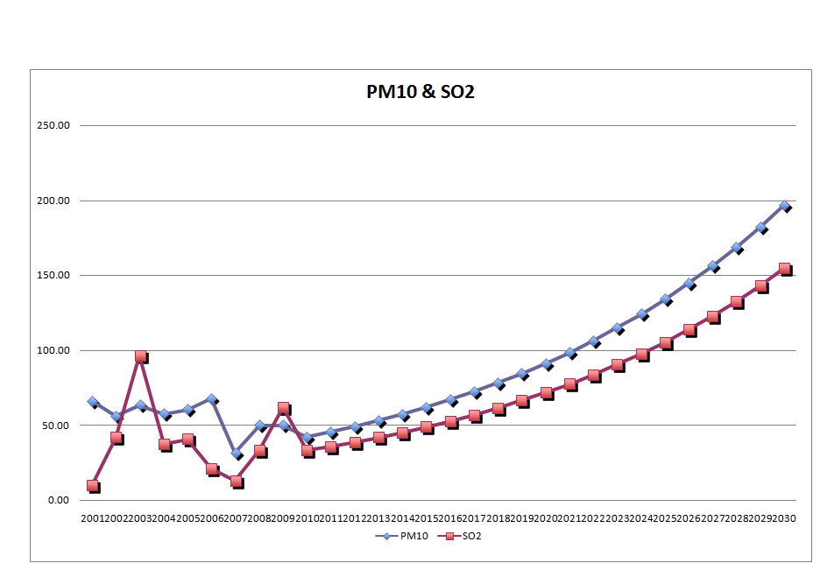
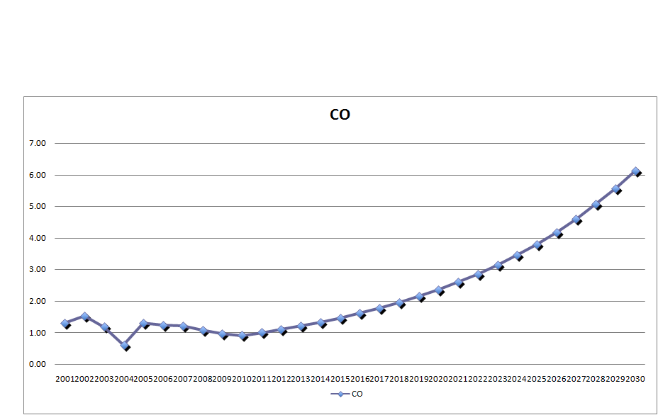
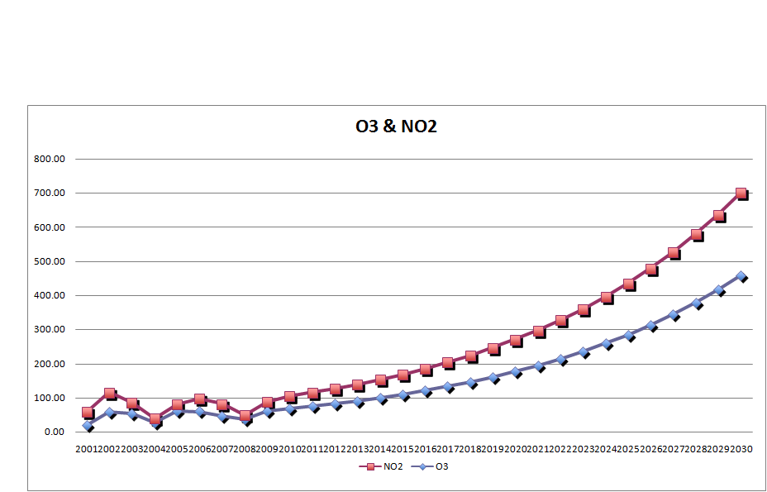
Pencemaran Udara dan Dampak Kesehatan
Case: Jakarta
PM₁₀, NO₂ and O₃ adalah parameter dominan pencemaran udara di Jakarta dengan sumber utama dari kendaraan bermotor.
57.8% warga Jakarta menderita sakit atau penyakit yang terkait dengan pencemaran udara (2010):
    1,210,581 orang menderita asthmatic bronchiale
    153,724 orang menderita bronchopneumonia
    2,449,986 orang menderita ISPA
    336,273 orang menderita pneumonia
    153,724 orang menderita COPD
    1,246,130 orang menderita coronary artery diseases
  Biaya Kesehatan yang dibayar warga Jakarta atas sakit/penyakit di atas Rp 38,5 T.

Slide 5
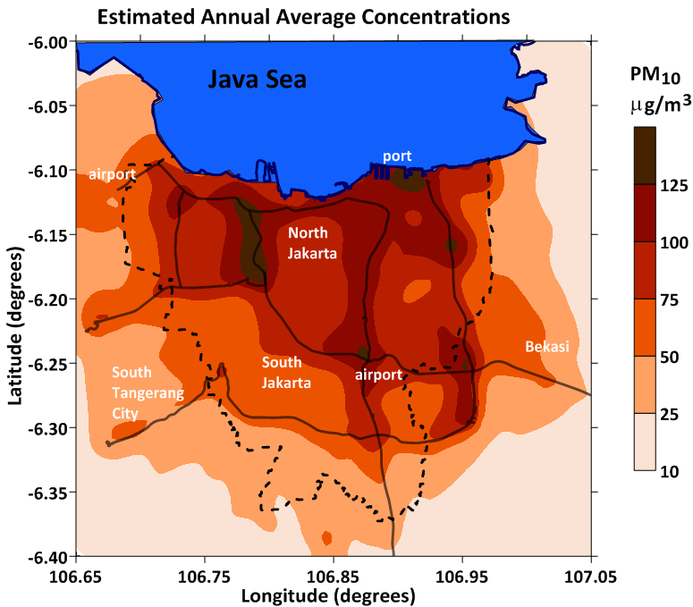
Modeled using ATMoS dispersion model and
WRF meteorological fields
Source: Breathe Easy Jakarta, 2015

Slide 6
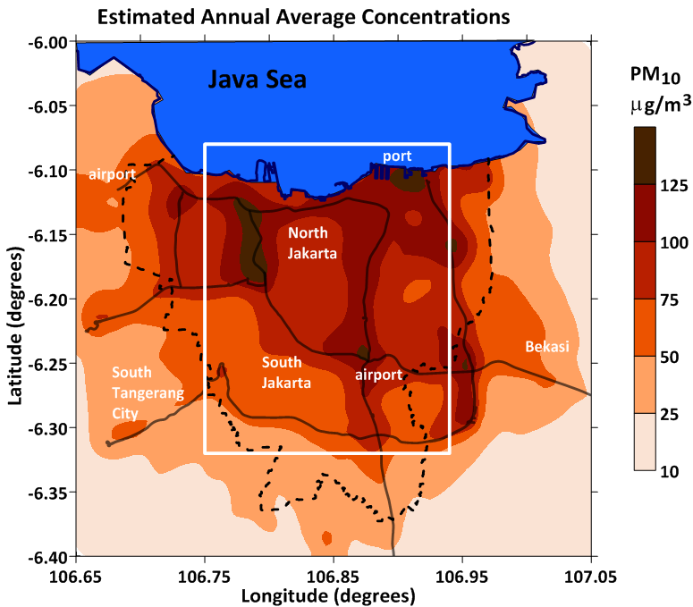
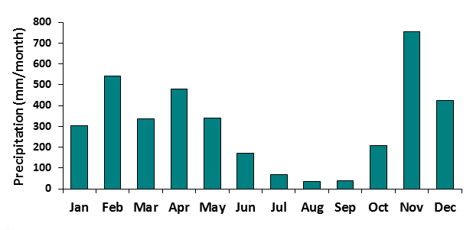
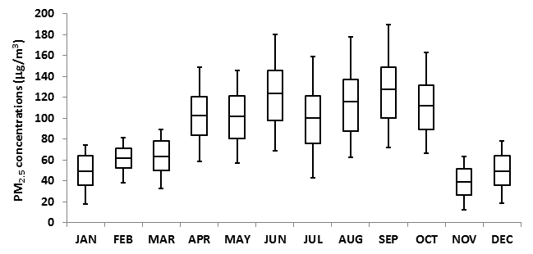
Modeled using ATMoS dispersion model and
WRF meteorological fields
Monthly variation in the PM₁₀ concentrations
Designated Urban area
Source: Breathe Easy Jakarta, 2015

Slide 7
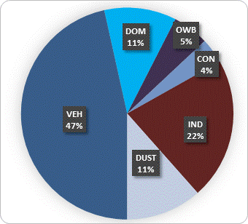
Modeled using ATMoS dispersion model and
WRF meteorological fields
Average source contributions
Designated Urban area
Source: Breathe Easy Jakarta, 2015

Slide 8

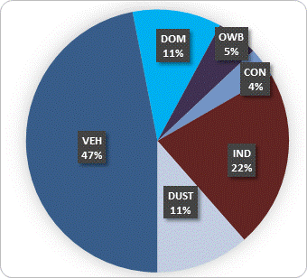
Modeled using ATMoS dispersion model and
WRF meteorological fields
Average source contributions
Designated North Jakarta area
Source: Breathe Easy Jakarta, 2015

Slide 9
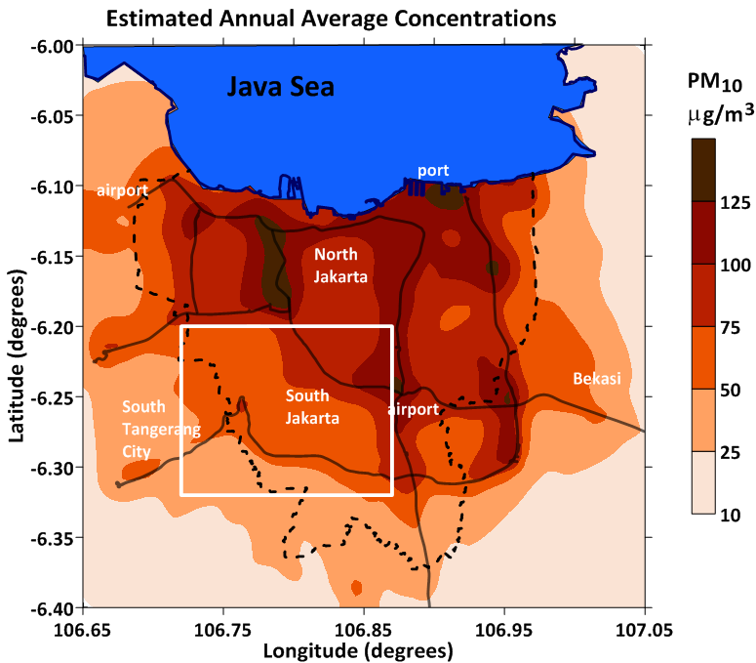
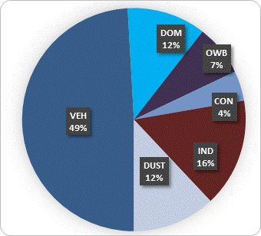
Modeled using ATMoS dispersion model and
WRF meteorological fields
Average source contributions
Designated South Jakarta area
Source: Breathe Easy Jakarta, 2015

Slide 10
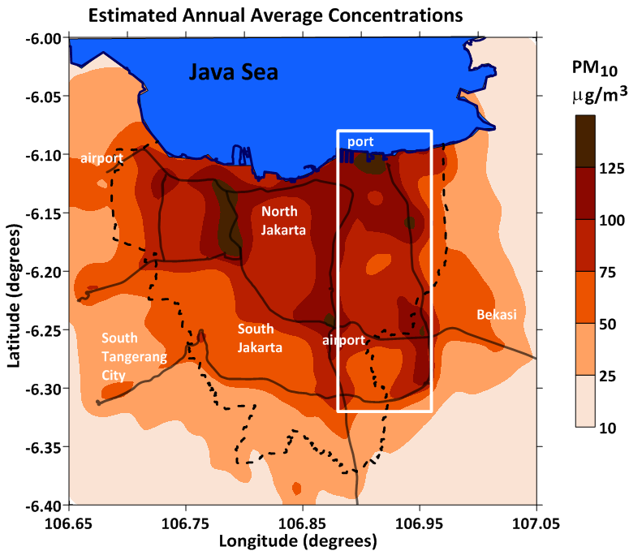
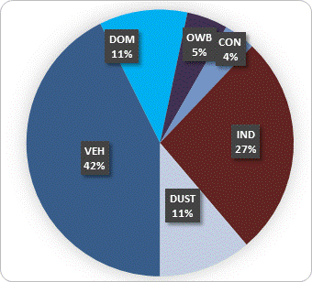
Modeled using ATMoS dispersion model and
WRF meteorological fields
Average source contributions
Designated East Jakarta area
Source: Breathe Easy Jakarta, 2015

Slide 11
Status of Public Transport
No |  | Jenis Kendaraan | Jumlah | Jenis Bahan Bakar
 |  |  |  | Gas | BBM
Angkutan Umum
1 | Bus Besar: Non Busway Busway/BRT |  | 6.440 883 | - 883 | 4.540 0
2 | Bus Sedang |  | 5.979 |  | 5.979
3 | Minibus: Microlet KWK APB |  | 6.746 6.238 1.096 | 36 - | 6.710 6.238 1.096
4 | Taksi |  | 24.256 | 2.360 | 21.896
5 | Bajaj |  | 14.424 | 400 | 14.024
6 | Lain-lain |  | 25.827 | - | 25.827
Kendaraan Operasional Pemda DKI Jakarta |  |  | 9.237 | - | 9.237
 |  | Total | 101,348 | 3,896 | 98,552
Sumber: Dinas Perhubungan Provinsi DKI Jakarta, 2015
Excellence Trigger from Governor DKI Jakarta to provide and operate 108 Euro 6 Standard of buses with CNG (2015)

Slide 12
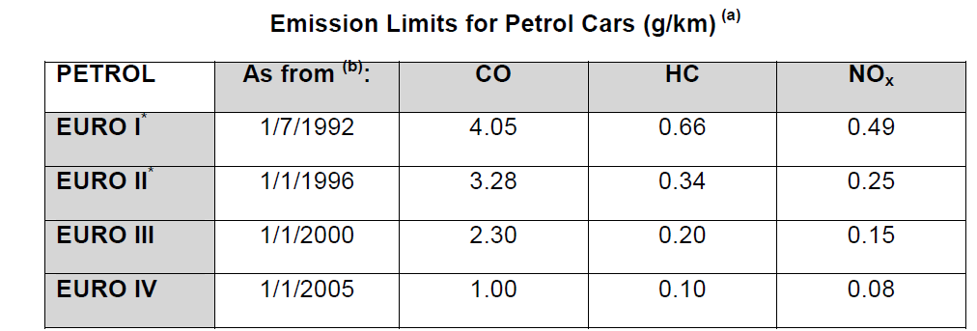
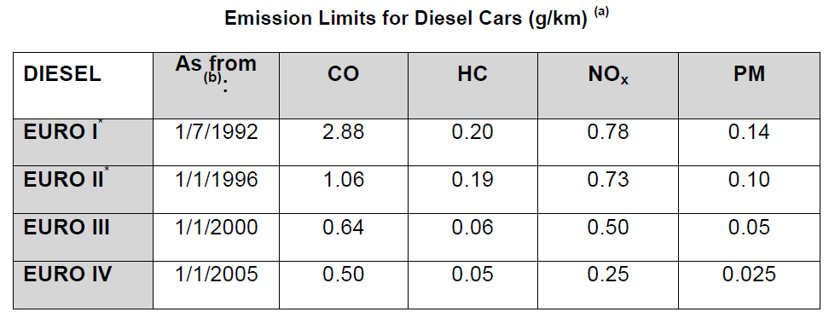
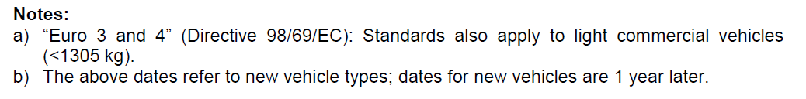
Adopsi Low Emission Vehicle Standard
Technical Solution untuk Pengendalin Pencemaran Udara

Slide 13
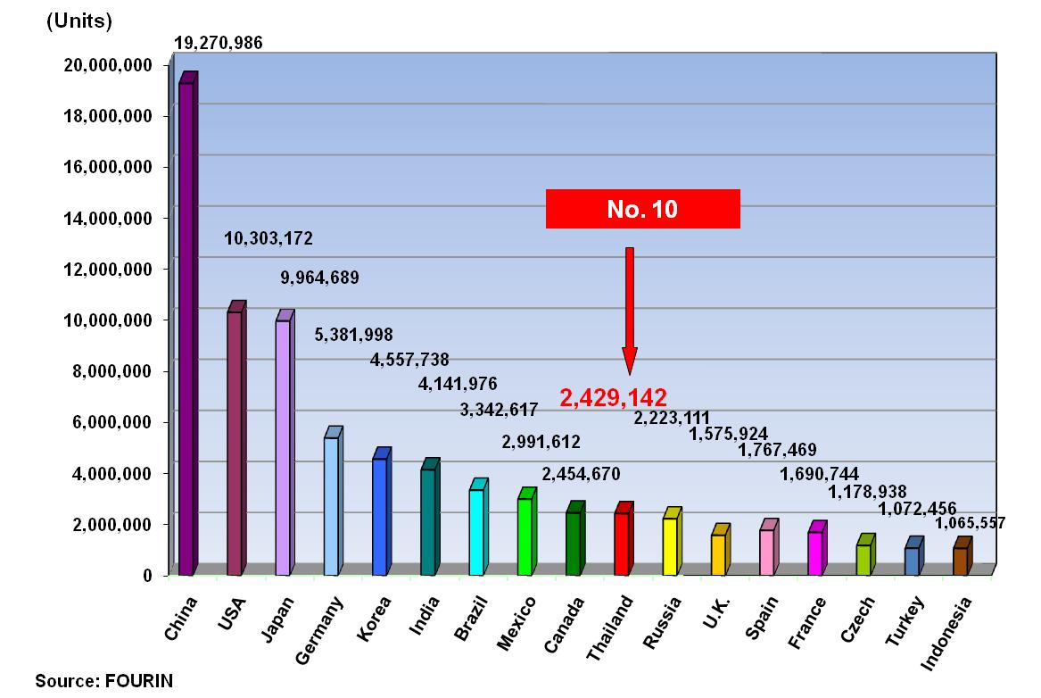
Global Automobile Production Ranking 2012
No 18
Buruknya kualitas BBM di Indonesia menjadi dalih bagi Auto-industry untuk tidak mengembangkan advance tech of vehicle (Low Emission Vehicle dan Low Carbon Emission Vehicle) yang diminati oleh konsumen saat ini: Principle produsen otomotif memusatkan produksi di Thailand sejak 2003/2004, sehingga industri otomotif Indonesia tidak mampu menguasai pasar otomotif di Indonesia sebagai pasar terbesar di Asia Tenggara.
Notes:
13

Slide 14
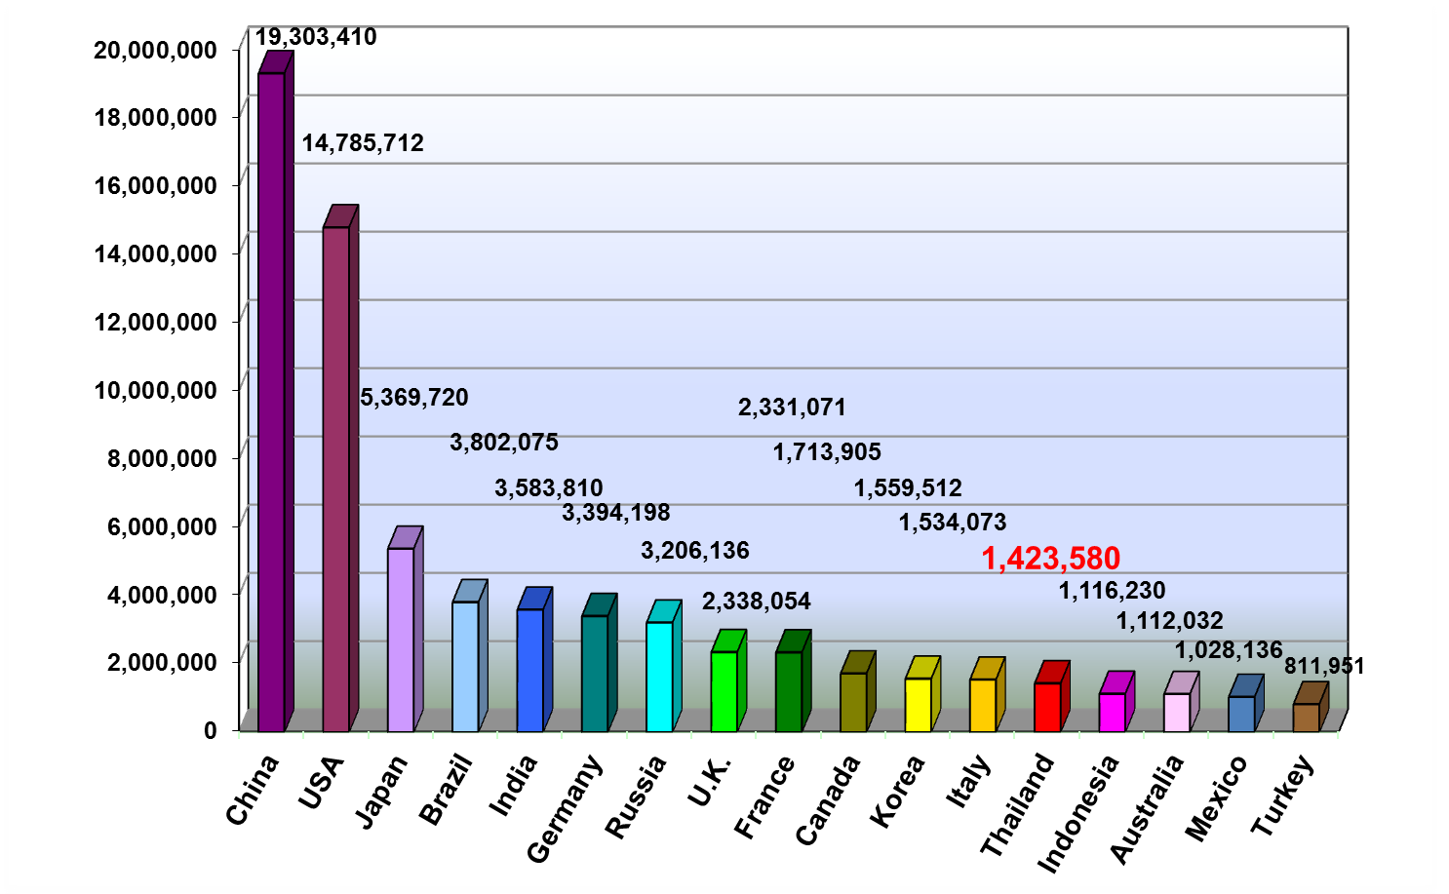
Global Automobile Sale Ranking 2012
(Units)
No. 13
No 14
Source: FOURIN
Ceruk pasar advance tech of vehicle (Low Emission Vehicle dan Low Carbon Emission Vehicle) diisi oleh Thailand:
Thailand adalah leading market di Asia Tenggara sejak 2002.
Thailand mengadopsi Standard Euro 2 (Fuel and Vehicle) sejak 1997, sementara Indonesia baru 2007.
Sejak 2012 Thailand beranjak mengadopsi Standard Euro 4
Sejak 2012 Thailand mampu memproduksi 2,4 juta unit mobil yang 1,8 juta unit diantaranya untuk target ekspor.
Percepatan Adopsi Standard Emisi Kendaraan sangat berpengaruh terhadap daya saing industri otomotif di pasar regional Asia Tenggara.
Notes:
14

Slide 15
Formulasi Kebijakan Standard Euro 4
Policy Option | Title | Description | Parameter and Its Source
1 | Emission Standard | Implement Euro 2 at 2005, Euro 3 at 2015, and Euro 4 at 2020 | Table Appendix 3. Adopted Emission Factors (g/km) at 80,000 km, source : Coffe (2005)
2 | Fuel Efficiency +Option 1 | Enhance fuel Efficiency 10 % by 2015
3 | CNG +Option 1 | Convert to Gas for Passenger Cars and Bus, at least 1 % at 2009, 2 % at 2011, and at 5 % at 2021 | Assume Cost for Gas Coverter = $800 , Gas Fuel CO NO HC PM Reduction 0.89 0.53 0 0.85 Sources Evaluating the Emission Reduction Benefits of WMATA Natural Gas Buses, www.eere.energy.gov
4 | Catalytic Coverter+Option 1 | Use Catalytic Converter to Diesel vehicles (25 % of Passenger Car, Bus, and Truck) | Cost for Catalyc Coverter = $800 , Gas Fuel CO NO HC PM Reduction 0.0 0.15 0 0.5 Sources: Michael P.Walsh (May,2006)
5 | Hybrid Technology + Option 1 | Use Hybrid technology for Passenger cars and Bus, at least 0.05% at 2009, 0.1 % at 2011,0.5 % at 2016, and 1 % at 2021 | Cost for Catalyc Coverter = $10,000 Assume fuel efficiency increases about 4.1 times than non hybrid technology.
6 | Scapped + Option 1 | Scrapped the 50 % vehicles that more than 20 years old from 2009
7 | Biofuel + Option 1 | Convert to Biofuel for Passenger Cars and Bus, at least 1 % at 2009, 2 % at 2011, and at 5 % at 2021 | Cost for processing biofuel = IDR 4,584/Liter is taken from Hadi et.al,(2010),http://psp3.ipb.ac.id/jurnal/index.php/artikel/article/view/23 Gas Fuel CO NO HC PM Reduction 0.47 -0.22 0.46 0.55 Sources: Xue, J., Tony, E.G and Alan C.H (2011)
8 | Public Transport + Option 1 | Result passenger car and motor cycle shift to public transport at least 5% and 1% at 2011, 10% and 5 % at 2014, 20% and 10% at 2018 and 40% and 20% at 2025 | Invest on bus rapid transit and busway (2005-2015), commuter line (2010-2020), and MRT (2015-2025). Cost for Investment is provided in table 9. We have limitation to consider operating and maintanance cost as well as expected reveneue from tariff.
9 | Leapfrog Emission Standard + Option 1 | Implement Euro 2 at 2005, Euro 3 at 2013, and Euro 4 at 2016 | Implement Euro 2 at 2005, Euro 3 at 2013, and Euro 4 at 2016

Slide 16
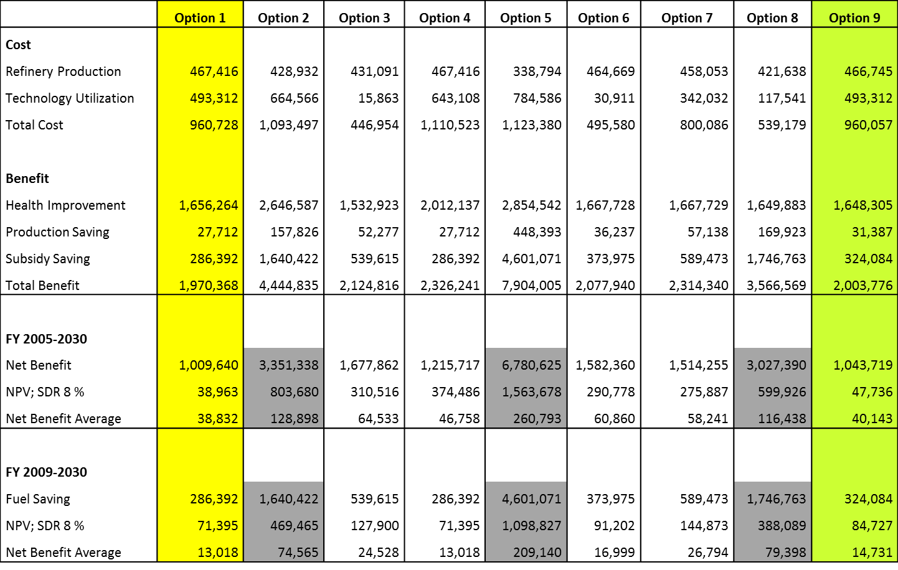
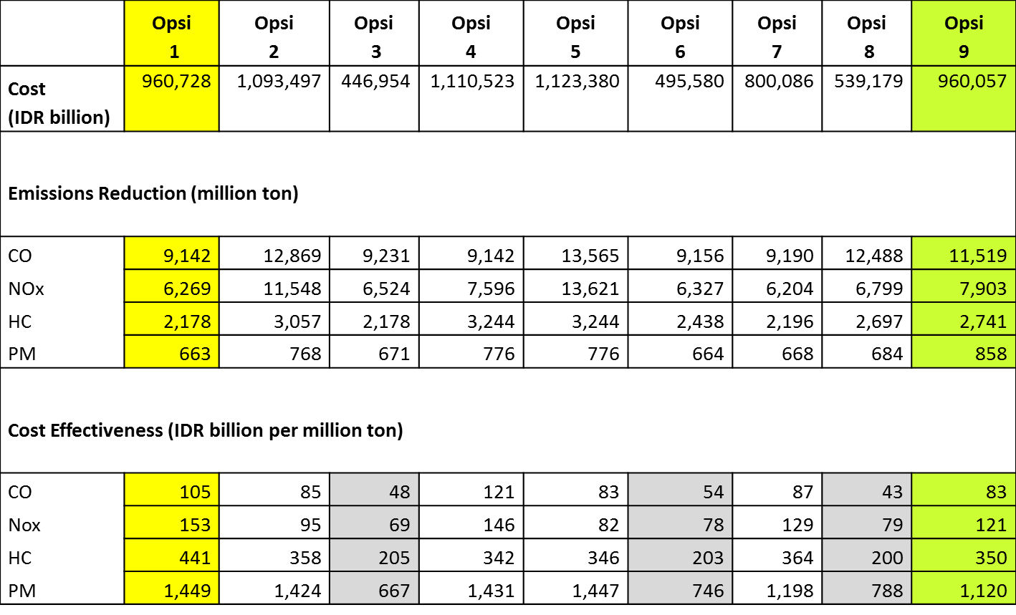
Cost Benefit and Effective
Vehicle Emission Standard (Euro 4)
2005-2030
Cost Benefit
Cost Effective
Cost Benefit Analysis and Cost Effective Analysis Berdasar Formulasi Kebijakan pada halaman 25:
Penerapan Standard Emisi Kendaraan berstandard Euro 4 pada 2021 (Option 1) akan memberikan Total Economic Benefit IDR 1.970 T (seribu sembilanratus tujuh puluh trilion Rupiah); yang mencakup pengurangann biaya kesehatan, peningkatan production saving dan penghematan BBM.
Namun demikian, percepatan penerapan Penerapan Standard Emisi Kendaraan berstandard Euro 4 pada 2016 (Option 9) akan meningkatkan (double) Total Economic Benefit Rp 3.973 T (tiga ribu sembilanratus tujuh puluh tiga trilion Rupiah); yang mencakup pengurangann biaya kesehatan, peningkatan production saving dan penghematan BBM dan memangkas biaya penurunan emisi hingga 21,30%.

Slide 17
Kualitas BBM
Prasyarat Adopsi Low Emission Vehicle Standard

Slide 18
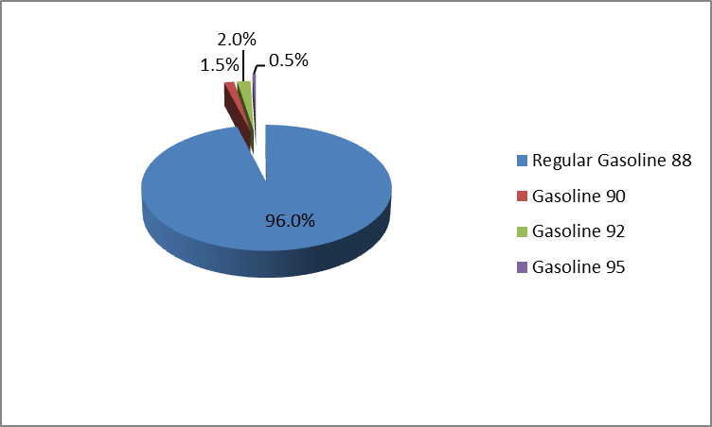
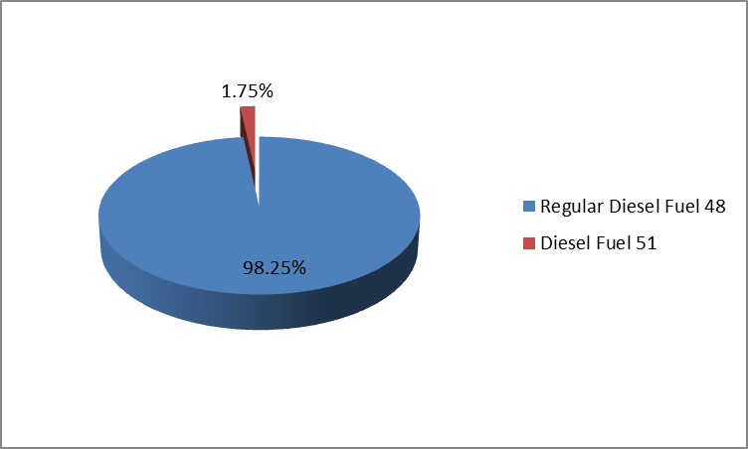
Jenis Bahan Bakar dan Total Penjualan Nasional (2015)

Slide 19
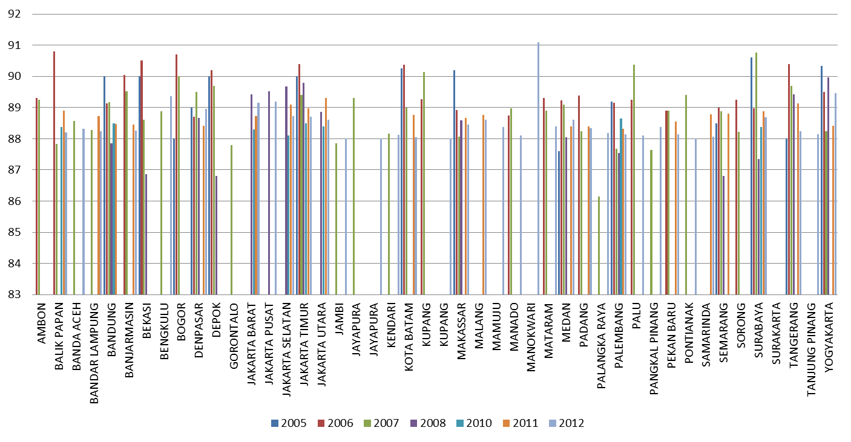
Kualitas Bensin - Series RON
Premium 88
Kualitas Premium 88 sangat bervariasi untuk setiap kota tergantung pada sumber/kilang BBM dan handling BBM yang belum menggunakan rubber sochet pada setiap noozle dispencer yang menyebabkan penguapan kandungan bensin (evaporative emissions). Ada kota-kota memperoleh Bensin RON kurang dari 87 tetapi sebaliknya ada kota-kota dengan Bensin RON lebih dari 89. Namun secara keseluruhan masih kurang dari RON 91 yaitu persyarakat RON minimal untuk Kendaraan Berstandard Euro 2 yang telah diadopsi sejak 2005.

Slide 20
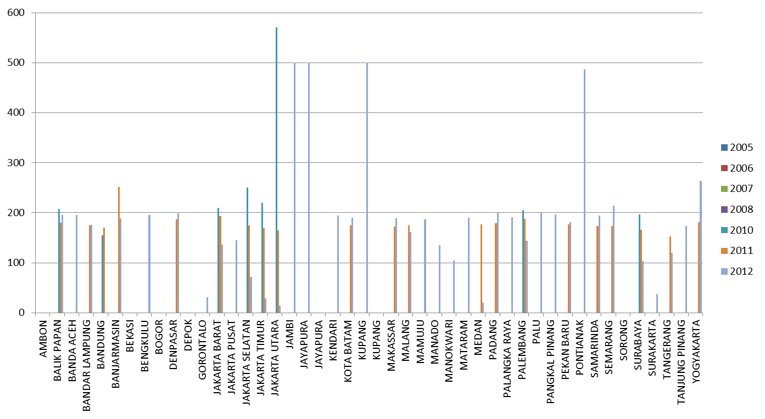
Kualitas Bensin – Sulfur Content
Premium 88
Kadar Belarang pada Premium RON 88 rata-rata adalah 200 ppm sekalipun ada beberapa kota yang masih dipasok dengan bensin berkadar belerang 500 ppm atau lebih. Untuk kota-kota yang dipasok Premium 88 dengan kadar Belerang lebih dari 500 ppm mengalami masalah pada kerusakan kendaraan bermotor (telah berstandard Euro 2 sejak 2005). Untuk mengadopsi Kendaraan Berstandard Euro 4 maka kadar belerang maksimal adalah 50 ppm.

Slide 21
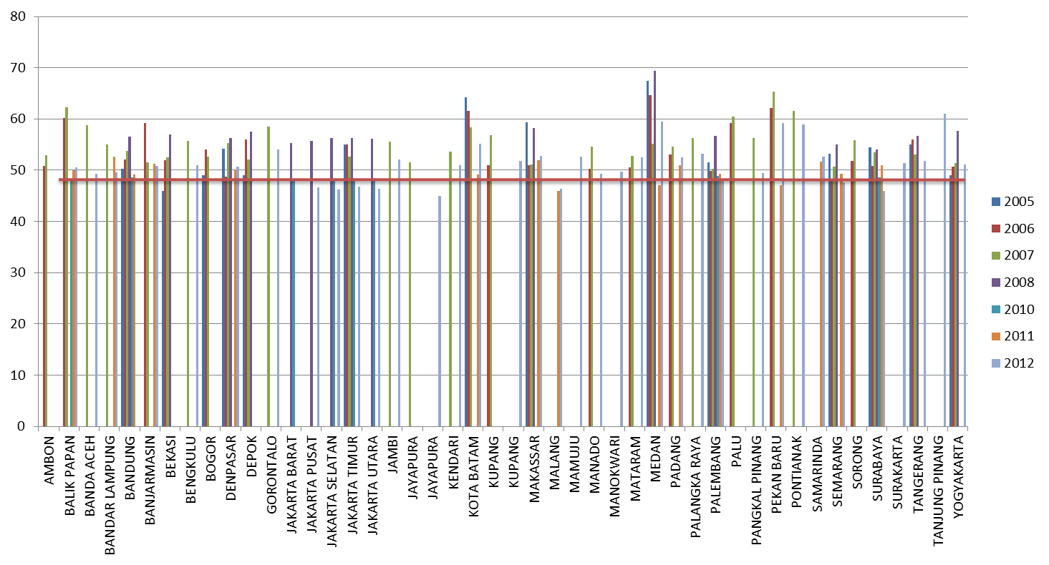
Kualitas Solar 48 - Series Cetane Index
Cetane Index Solar yang dipasok ke berbagai kota di Indonesia rata-rata adalah 48, sekalipun sebagian kota telah dipasok dengan Solar dengan Cetane Index di atas 50. Syarat Cetane Index untuk kendaraan berstandard Euro 2 maupun Euro 4 adalah 51.

Slide 22
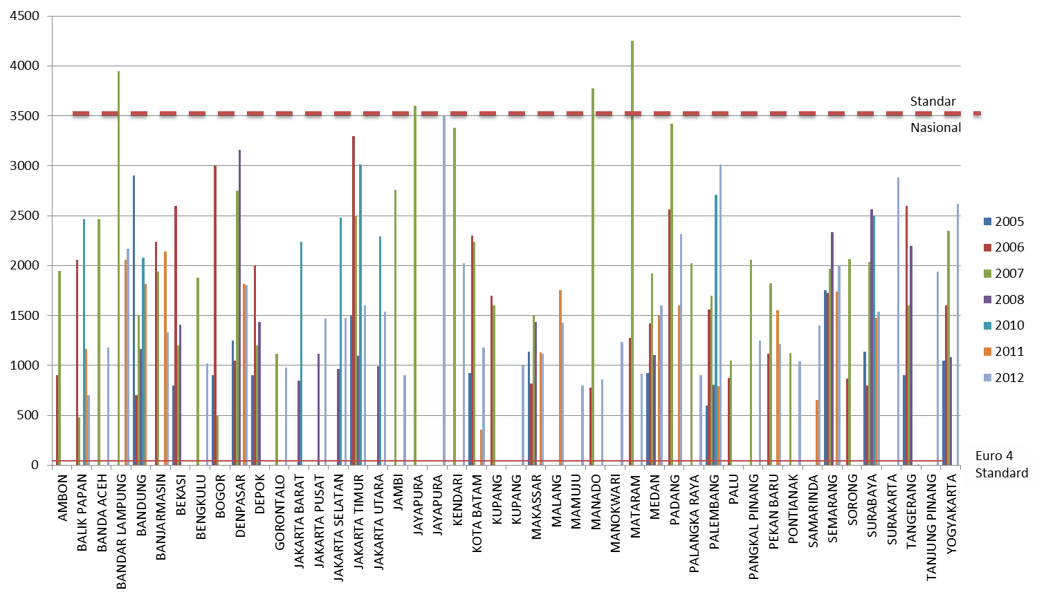
Kualitas Solar 48 - Series Sulfur
Kadar Belerang pada Solar masih sangat tinggi yaitu rata-rata 2000 ppm. Tentu ini menjadi kendala utama sehingga Regulasi Standard Euro 2 yang telah ditetapkan diberlakukan sejak 2005 tidak dapat diterapkan. Standard Euro 2 menghendaki kadar belerang maksimal adalah 500 ppm sementara Standard Euro 4 adalah maksimal 50 ppm.

Slide 23
Technical Effect
BBM yang tak sesuai dengan engine technology requirement
Euro 2 Standard, UU No 32/2009 cq UU No 23/1997
PP No 41/1999, Permen LH No 141/2003
Kendaraan Bensin:
Konsekuensi penerapan Standar Euro 2, kini semua varian sepeda motor dan mobil memiliki compression ratio minimal 9:1.
  Kendaraan kecil sekelas sepeda motor scoopy memiliki compression ratio 9,2:1.
  Mobil LCGC dan MPV kelas 1500 cc ke bawah memiliki compression ratio 10:1.
  Mobil kelas menengah 11:1,
  Mobil mewah 11:1 atau 12:1.
Kendaraan dengan compression ratio 9:1 membutuhkan Bensin dengan RON minimal 91. Sedangkan kendaraan dengan compression ratio 10:1 ke atas membutuhkan Bensin dengan RON minimal 95.
Jika dipaksakan, maka kendaraan akan ngelitik (knocking) dengan konsekuensi:
  Mobil menjadi tidak bertenaga karena bensin dengan RON lebih rendah dari kebutuhan mesinnya (engine requirement) akan terbakar oleh kompresi piston di ruang pembakaran mesin (self ignition) tanpa didahului percikan api busi;
  Self ignition ini menyebabkan bensin lebih boros sekitar 20% karena terbakar percuma tanpa menghasilkan tenaga sehigga untuk menempuh jarak tertentu membutuhkan bensin lebih banyak;
  Borosnya bensin ini juga meningkatkan emisi baik emisi rumah kaca (CO2) maupaun emisi pencemaran udara seperti PM, HC, CO, NOx, SOx; dan
  Terjadinya detonasi yang menyebabkan keretakan piston, kerusakan ring-piston, busi dll karena efek self ignition.
Kendaraan Solar:
Kendaraan Standard Euro 2 membutuhkan BBM dengan kadar belerang max 500 ppm. Solar 48 kita memiliki kadar belerang rata-rata 2000 ppm
Jika dipaksakan, maka Diesel Particulate Filter (DPF) akan mengalami kerusakan karena Sulfur (belerang). Karena dikendalikan secara elektronik maka kerusakan DPF akan menghentikan fungsi kendaraan scr keseluruhan.
Praktis tak ada lagi kendaraan yang membutuhkan Bensin dengan RON di bawah 91 dan atau Solar dengan kadar belerang lebih dari 500 ppm (Standard Euro 2). Sementara Kendaraan Berstandard Euro 4 harus tidak lebih dari 50 ppm.

Slide 24
Benchmark existing and roadmap fuel quality/pricing

Slide 25
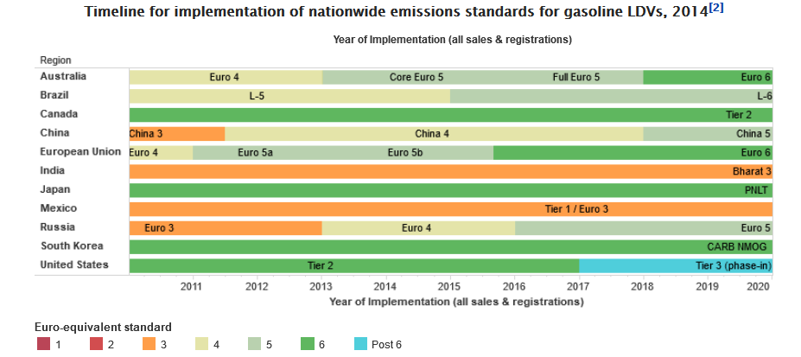

Slide 26
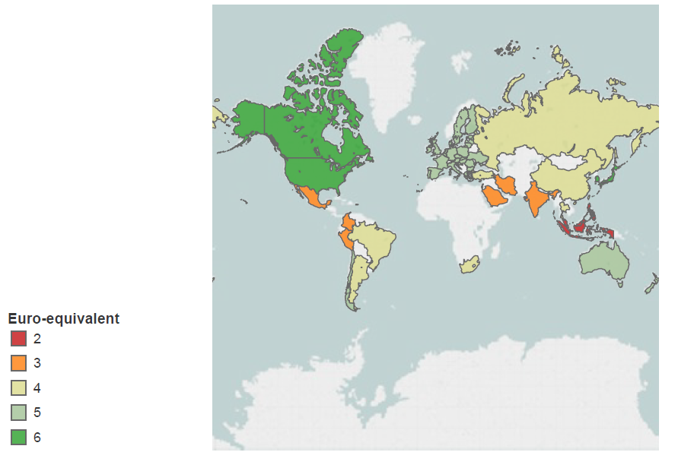

Slide 27
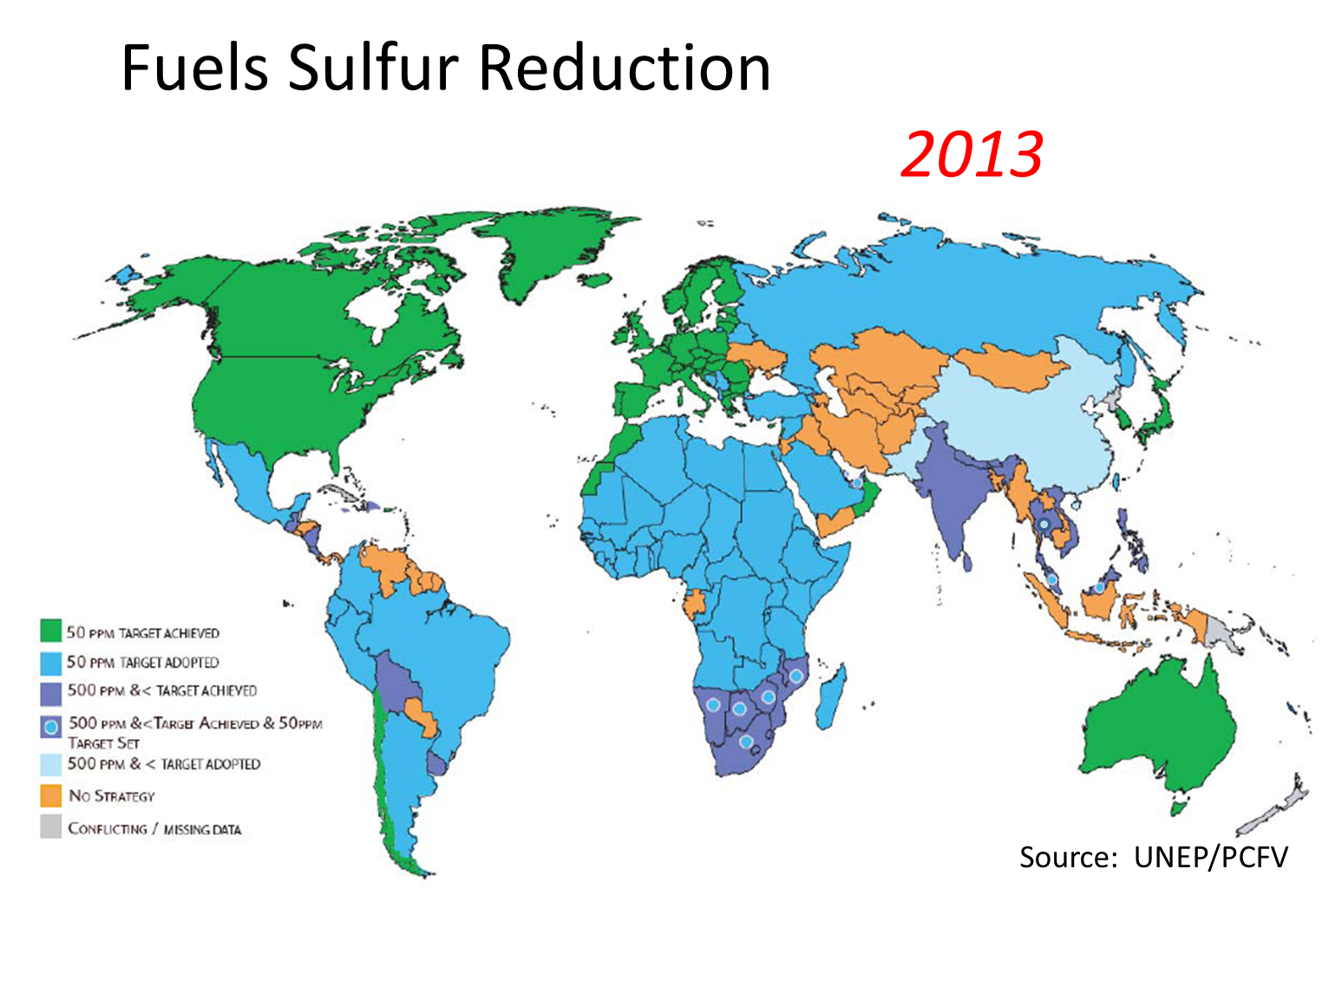

Slide 28
Menselaraskan Teknologi Kendaraan dan Kualitas BBM di Asia Tenggara
(Euro 4 Standard)
?
Source: AAF, processed

Slide 29
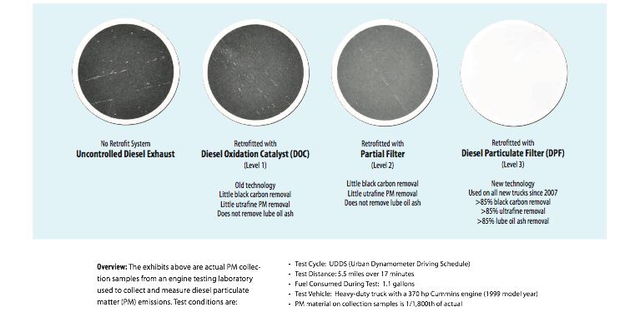
Technological Shift Towards Soot-Free Diesel Engines
Courtesy of ClearAire, Inc.

Slide 30
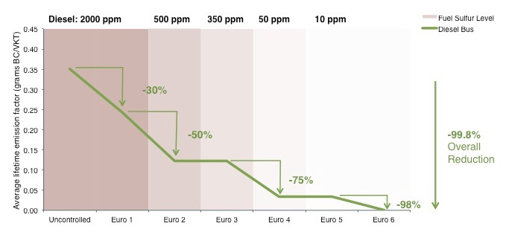
Urban Bus Fleets: Stages of Change
Stages of Black Carbon Emissions Control Based on European Regulatory Approach to Urban Bus Fleets
Source: COPERT Emissions Model

Slide 31
Benchmark Harga BBM

Slide 32
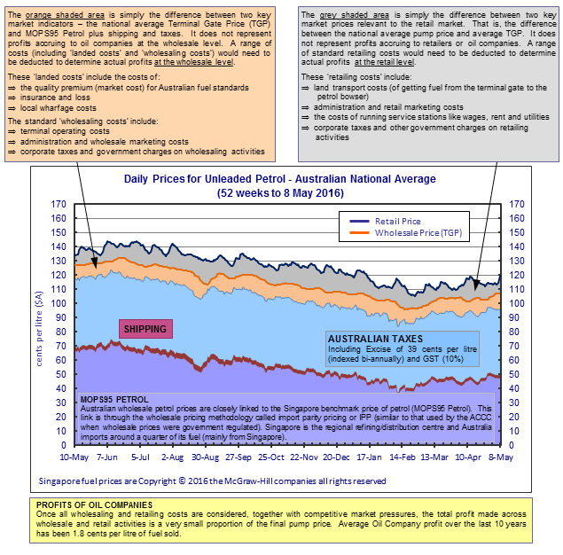
NOTES
(1) MOPS95 Petrol: the international petrol prices are provided by Platts (Copyright © 2016 The McGraw-Hill Companies, all rights reserved), and represent the end of day assessment for the mean of Singapore prices for 95 Octane Petrol (MOPS95 Petrol). No portion of the publication may be photocopied, reproduced, retransmitted, put into a computer system or otherwise redistributed, without prior written Authorisation from Platts. Platts is a trademark of the McGraw-Hill Inc. Information has been obtained from sources believed reliable. However, because of the possibility of human or mechanical errors by sources, McGraw-Hill or others, McGraw-Hill does not guarantee the accuracy, adequacy or completeness of any such information and is not responsible for any errors or omissions or for results obtained from use of such information.
(2) SHIPPING: is the weighted average of daily market shipping rates (Australian cents per litre) for journeys from Singapore to major Australian ports (weighted by the volume of fuel sales in the relevant State). Source data include Platts, Worldscale, Australian Petroleum Statistics and the Reserve Bank of Australia.
(3) TAXES: is excise and GST less any relevant state rebates weighted by the volume of petrol consumed in each State.
(4) NATIONAL AVERAGE WHOLESALE PRICES: are derived from capital city prices weighted by fuel volume consumed in each State.
(5) NATIONAL AVERAGE RETAIL PRICES: are calculated as the weighted average of each State/Territory's metropolitan and non metropolitan retail petrol prices, with the weights based on the number of registered petrol vehicles in each of these regions.
http://www.aip.com.au/pricing/facts/Weekly_Petrol_Prices_Report.htm
Australia memperoleh Bensin dg Harga MOPS rata-rata 47 cent A$ atau setara dengan Rp 4700/L (BBM dg spec untuk kendaraan standard Euro 6)

Slide 33
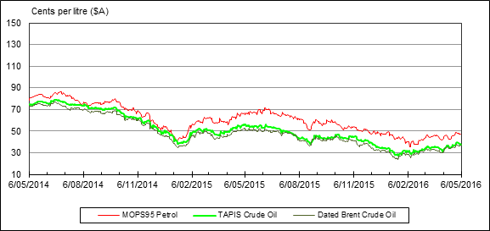
INTERNATIONAL MARKET TRENDS
FIGURE: COMPARISON OF SINGAPORE PETROL PRICE (MOPS95 PETROL) WITH CRUDE OIL PRICES
NOTE: Australia is part of the Asia-Pacific fuel market (Singapore is the regional refining/distribution centre) and relevant pricing benchmarks in this market are Singapore petrol prices for unleaded petrol (MOPS95 Petrol) and Tapis and Dated Brent for crude oil. Prices for MOPS95 Petrol and for Tapis and Dated Brent crude oil are provided by Platts (The McGraw-Hill Companies, Inc). Platts have publicly reported that countries across the Asia-Pacific region including Australia are increasingly moving to using Dated Brent as the relevant crude pricing benchmark for crude oil contract purposes and spot transactions. Caltex Australia has also indicated in public statements a shift to Dated Brent crude pricing. For information on crude oil pricing and Dated Brent pricing in Asia see www.aip.com.au/pricing/crude.htm.

Slide 34
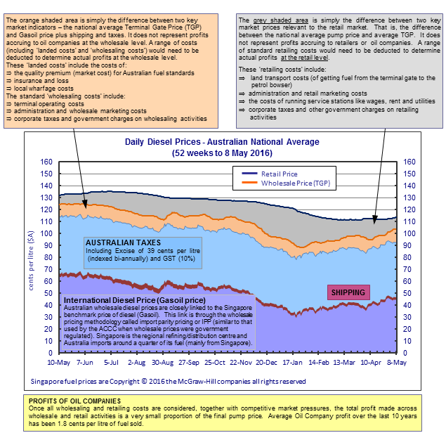
NOTES
(1) INTERNATIONAL DIESEL PRICE: the international diesel prices are provided by Platts (Copyright © 2016 The McGraw-Hill Companies, all rights reserved), and represent the end of day assessment for the price of Gasoil (50ppm sulfur from 1 January 2006, and 10ppm Sulfur from 1 January 2009). No portion of the publication may be photocopied, reproduced, retransmitted, put into a computer system or otherwise redistributed, without prior written Authorisation from Platts. Platts is a trademark of the McGraw-Hill Inc. Information has been obtained from sources believed reliable. However, because of the possibility of human or mechanical errors by sources, McGraw-Hill or others, McGraw-Hill does not guarantee the accuracy, adequacy or completeness of any such information and is not responsible for any errors or omissions or for results obtained from use of such information.
(2) SHIPPING: is the weighted average of daily market shipping rates (Australian cents per litre) for journeys from Singapore to major Australian ports (weighted by the volume of fuel sales in the relevant State). Source data include Platts, Worldscale, Australian Petroleum Statistics and the Reserve Bank of Australia.
(3) TAXES: is excise and GST less any relevant state rebates weighted by fuel volume consumed in each State.
(4) NATIONAL AVERAGE WHOLESALE PRICES: are derived from capital city prices weighted by fuel volume consumed in each State.
(5) NATIONAL AVERAGE RETAIL PRICES: are calculated as the weighted average of each State/Territory's metropolitan and non metropolitan retail diesel prices, with the weights based on the number of registered diesel vehicles in each of these regions.
http://www.aip.com.au/pricing/facts/Weekly_Diesel_Prices_Report.htm
Australia memperoleh Solar dengan Harga MOPS rata-rata 42 cent A$ atau setara dengan Rp 4200/L (BBM dg spec untuk kendaraan standard Euro 6)

Slide 35
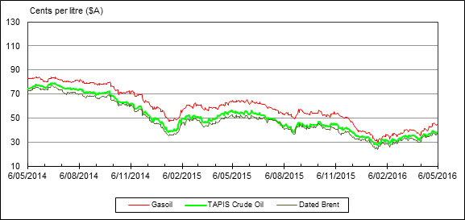
INTERNATIONAL MARKET TRENDS
FIGURE: COMPARISON OF SINGAPORE DIESEL PRICE (GASOIL) WITH CRUDE OIL PRICES
NOTE: Australia is part of the Asia Pacific fuel market (Singapore is the regional refining/distribution centre) and the relevant pricing benchmarks in this market are Singapore prices for diesel (Gasoil 10ppm sulfur) and Tapis and Dated Brent for crude oil. Prices for Gasoil 10ppm sulfur diesel and for Tapis and Dated Brent crude oil are provided by Platts (The McGraw-Hill Companies, Inc). Platts have publicly reported that countries across the Asia-Pacific region including Australia are increasingly moving to using Dated Brent as the relevant crude pricing benchmark for crude oil contract purposes and spot transactions. Caltex Australia has also indicated in public statements a shift to Dated Brent crude pricing. For information on crude oil pricing and Dated Brent pricing in Asia see www.aip.com.au/pricing/crude.htm.

Slide 36
Perbandingan Harga MOPS
Mids Oil Platts Singapore

Slide 37
Australia – Retail Fuel Price
Average January – April 2016
Fuels Spec Comply for Euro 6 Standard
Table 1
ITEM | Gasoline RON 95 S max 10 | Diesel 51 S max 10
Harga SPBU per L (A$) | 1.10 | 1.03
~ Harga SPBU per L (Rp) | 10,974.70 | 10,309.20
Cost Structure:
Retailing Cost | 10% | 10%
Landed Cost (Nat'l Average Terminal Gate Price OHC) | 10% | 10%
Good and Service Tax | 10% | 10%
Excise (A$) | 0.39 | 0.39
HPP - MOPS per L (A$) | 0.47 | 0.42
~ HPP - MOPS per L (Rp) | 4,700.00 | 4,200.00

Slide 38
MALAYSIA - Harga Bensin RON 95
Sulfur max 50 ppm ~ Spec for Euro 4 Standard
Table 2a
Kurs Rp/RMY | 3,340.00 | 3,340.00
Harga (RMY) | 1.70 | 1.70
Harga SPBU (Rp) | 5,678.00 | 5,678.00
MOPS (Rp) | ? | 4,060.30
Alpha (Rp) | 167.0000 | 167.00 | 5 sen
Opr Cost (Rp) | 318.6360 | 318.63 | 9,54 sen
OC Margin (Rp) | 167.0000 | 167.00 | 5 sen
SPBU Margin (Rp) | 407.1460 | 407.14 | 12,19 sen
Sales Tax/ Subsidy (Rp) | 1,957.9080 | 557.90 | 58,62 sen by Government Discretion
Harga SPBU (Rp) | 5,678.00 | 5,678.00

Slide 39
MALAYSIA
Harga Solar 51 Sulfur max 50 ppm
~ for Euro 4 Standard
Table 2b
Kurs RMY/RP |  |  | 3,340.00
Harga SPBU (RMY) |  |  | 1.55
Harga SPBU Rp |  |  | 5,177.00
MOPS (Rp) |  | 3,341.19 | 3,841.19
Alpha (Rp) |  | 207.08 | 207.08 | 4 sen
Opr Cost (Rp) |  | 493.89 | 493.89 | 9,54 sen
OC Margin (Rp) |  | 116.48 | 116.48 | 2,25 sen
SPBU Margin (Rp) |  | 362.39 | 362.39 | 7 sen
Sales Tax/Subsidy (Rp) |  | 655.97 | 155.97 | 19,64 sen by Government Discretion
Harga SPBU (Rp) |  | 5,177.00 | 5,177.00

Slide 40
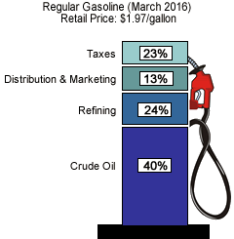
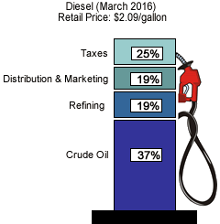
US – Retail Fuel Price
Average March 2016
Fuels Spec Comply for Euro 6 Standard
Table 3
ITEM | Gasoline RON 92 S max 10 | Diesel 51 S max 10
Harga SPBU per USG (US$) | 1.97 | 2.09
Harga SPBU per L (US$) | 0.52 | 0.55
~ Harga SPBU per L (Rp) | 6,721.78 | 7,131.23
Percentage HPP (Refinery) | 64% | 56%
HPP (Refinery) per USG (US$) | 1.26 | 1.17
HPP (Refinery) per L (US$) | 0.33 | 0.31
~ HPP (Refinery) per L (Rp) | 4,301.94 | 3,993.49

Slide 41
Perbandingan Harga BBM MOPS
Table 4
NEGARA | Bensin | Solar | Fuels Spec
Indonesia | 5,200.00 | 5,200.00 | Euro 1 or bellow
Malaysia | 4,060.00 | 3,841.00 | Euro 4
Australia | 4,700.00 | 4,200.00 | Euro 6
USA Cost of Goods Sold (Harga Pokok Penjualan) | 4,301.00 | 3,993.00 | Euro 6
Harga perolehan sebelum dikenakan pajak sesuai dengan kebijakan fiskal di negara masing-masing.

Slide 42
Proyeksi Kebutuhan BBM
Kendaran Standard Euro 4
Table 5
Penjualan Kendaraan Per Tahun dan
Antisipasi Kebutuhan BBM untuk Kendaraan Standard Euro 4
Jenis Kendaraan | Total Kendaraan | Total Kendaraan |  | Volume Konsumsi BBM L/hari |  | Volume Konsumsi BBM L/tahun
 |  | Bensin | Solar | Bensin | Solar | Bensin | Solar
Mobil | 1,100,000 | 605,000 | 495,000 | 9,075,000 | 7,425,000 | 2,904,000,000 | 2,376,000,000
Sepeda Motor | 5,000,000 | 5,000,000 |  | 7,500,000 |  | 2,400,000,000
Table 6
Proyeksi Kebutuhan BBM untuk Kendaraan Standard Euro 4
Jenis BBM | 2017 | 2018 | 2019 | 2020 | 2021
Bensin | 5,304,000,000 | 10,608,000,000.00 | 15,912,000,000.00 | 21,216,000,000 | 26,520,000,000
Solar | 2,376,000,000 | 4,752,000,000.00 | 7,128,000,000.00 | 9,504,000,000 | 11,880,000,000

Slide 43
Proyeksi Kebutuhan BBM untuk Standard Euro 4
Table 7: Impor BBM Saat ini (Existing of Imported Fuels)
Import BBM Saat Ini |  | Harga MOPS Versi Pertamina
Bensin | 12,000,000,000 | Rp 5,200.00 | Rp 62,400,000,000,000.00
Solar | 3,000,000,000 | Rp 5,200.00 | Rp 15,600,000,000,000.00
Total Kebutuhan Impor BBM |  |  | Rp 78,000,000,000,000.00
Table 8: Proyeksi Impor BBM
untuk Memenuhi Kebutuhan Kendaraan Standard Euro 4 pada 2017
 | 2017 | Harga MOPS
Bensin | 5,304,000,000 | Rp 4,500.00 | Rp 23,868,000,000,000.00
Solar | 2,376,000,000 | Rp 4,200.00 | Rp 9,979,200,000,000.00
 |  |  | Rp 33,847,200,000,000.00
Table 9: Shifting Impor BBM dari Kualitas Non Euro
Menjadi Impor BBM Sesuai Kebutuhan Kendaraan Standard Euro 4 pada 2017
Import BBM Saat Ini |  | Harga MOPS
Bensin | 12,000,000,000 | 4,500.00 | 54,000,000,000,000.00
Solar | 3,000,000,000 | 4,200.00 | 12,600,000,000,000.00
 |  |  | 66,600,000,000,000.00

Slide 44
Euro 6 Standard - Fuel Efficiency
Kendaraan dengan standard yang lebih tinggi memiliki potensi lebih hemat BBM (fuel efficiency), dengan perkiraan berdasarkan empiris penerapan Euro 2 Standard di bandingkan non Euro Standard adalah sekitar 20%.
Untuk tingkat efficiency penerapan Euro 4 Standard sebagai leapfrog dari Euro 2, memang belum diuji. Tetapi para ahli otomotif memperkirakan akan terjadi efficiency pada kisaran 10 – 20%, dengan penjelasan:
  Bahwa kendaraan teknologi tua seperti standard Euro 2 di beberapa negara adalah discontinue karena tak mampu mengikuti standard yang lebih baik.
  Sebagai gantinya adalah diadopsi teknologi kendaraan yang lebih baik yang memiliki konsekuensi konsumsi BBM yang lebih efisien.
  Untuk kendaraan solar, agar memenuhi standard Euro 2, kendaraan menggunakan teknologi indirect injection, beberapa di antaranya dengan direct injection.
  Tetapi untuk memenuhi Euro 4 Standard perlu menerapakn teknologi common rail system yang tercipta high injection pressure yang memungkinkan penyemprotan BBM secara otomatis dan lebih bersih sehingga pembakaran menjadi lebih efisien. Berikut penjelasan dari DR Michael Walsh dan DR Anup Bandivandekar dari ICCT⁽¹):
    There is no trade off what so ever. On the play side, what we know from experience in India, many older gasoline engines will have to phased out to make way for Euro 4. The best example of Maruti 800. The car was discontinued after being in the market for nearly 25 years, its old engine being tinkered to meet BS II and III emission standards. The newer engines have variable valve timing, 4 valves per cylinder, and higher fuel efficiency.
    In the case of diesels, the case is even clearer. Euro 2 could be met by indirect injection diesels. Some may have direct injection, but to meet Euro 4, common rail system will be necessary. High injection pressures in this case lead to better spray atomization and cleaner as well as more efficient combustion.
¹ Ahli dari the International Council for Clean Transportation khusus menjawab pertanyaan dalam persiapan penerapan Euro 4 Standard di Indonesia, 7 Juli 2016

Slide 45
Ringkasan dan Rekomendasi
Adopsi advance technology akan memberikan manfaat dalam penurunan pencemaran udara dan peningkatan daya saing industri (minyak dan otomotif)
Existing Imported Fuels: Impor BBM saat ini sekitar 12 juta KL/tahun (Bensin) dan 3 juta KL/tahun (Solar) dengan total nilai Rp 78 T.
Berdasarkan benchmarking harga MOPS (Australia dan Malaysia) serta harga perolehan (HPP atau Cost of Goods Sold) Amerika Serikta:
  Opsi 1: Partial Imported Fuels for Euro 4 Standard. Proyeksi kebutuhan BBM untuk memenuhi Kendaraan Standard Euro 4 pada 2017 ketika diterapkan pada 2017 adalah 5,3 juta KL/tahun (Bensin) dan 2,37 KL/tahun (Solar) dengan total nila Rp 33,8 T:
    Dipenuhi hanya dengan mengganti jenis BBM impor saat ini dengan kualitas yang sesuai kebutuhan Standard Euro 4.
    Dengan kata lain tidak ada penambahan volume impor dari exisiting imported fuels.
    Opsi ini lebih murah Rp 6,088 T dibandingkan Existing Imported Fuels.
  Opsi 2: Total Shifting to Imported Fuels for Euro 4 Standard. Ada baiknya seluruh volume existing impor BBM diganti dengan BBM yang kualitasnya sesuai dengan Kebutuhan Kendaraan Standard Euro 4 yang mencapai sekitar 12 juta KL/tahun (Bensin) dan 3 juta KL/tahun (Solar) dengan total nilai Rp 66,6 T.
    Opsi ini lebih murah Rp 11,4 T dibandingkan Existing Imported Fuels.
Harus ada Reformulasi Harga MOPS sesuai dengan fakta harga pasar di Bursa Minyak Regional (Singapura, dll) sehingga lebih ada kepastian dan transparansi terkait harga perolehan (seperti harga MOPS) yang dijadikan sebagai HPP (Harga Pokok Penjualan atau Cost of Goods Sold) BBM.
  Hedging dan kontrak import BBM berdasar kontrak pembelian komoditas berjangka.
  Monitoring terhadap trend Fuel Price di Bursa Minyak Regional.
Kendaraan dengan standard lebih tinggi memiliki efisiensi lebih baik. Adopsi Euro 4 standard mampu meningkatkan fuel efficiency antara 10 – 20% dibandingkan Euro 2 Standard.
Fuel Efficiency yang tercipta sebaiknya dikompensasikan ke fiscal policy dengan penerapan carbon tax sehingga mendorong pengguna BBM untuk turut bertanggung jawab atas pemakaian BBM baik untuk tujuan ketahanan energi maupun dalam kerangka pengurangan green house gas.

